Slide 1

EQUITY CERTIFICATES
AND THEIR ELIGIBILITY
AS CET1 CAPITAL
ANDREA RESTI
BOCCONI UNIVERSITY
andrea.resti@unibocconi.it

Slide 2

Today’s speaker
Andrea C. Resti is a professor of banking and finance at Bocconi university, Milan, where he teaches financial risk management.
In 2011-2016 he took part in the first European Banking Authority’s Stakeholder Group, where he served as vice-chair and coordinated the Group’s activities on bank liquidity rules.
Since 2016 he has served as a consultant on banking supervision to the European Parliament
He has acted as a consultant to a large number of banks, rating agencies and supranational institutions, and as an expert witness in financial misconduct cases. He is/has been a board member at various financial institutions.
He has published international books and articles in top academic journals, as well as many ad hoc reports requested by the European Parliament and more than 500 columns in financial newspapers and websites.

Slide 3
Outline of today’s talk
Some relevant features of Equity Certificates
The main rules on CET1 eligibility
The EBA’s concerns and the proposals by the MoF Commission
My opinion
Stakeholder banks and the risks ahead

Slide 4
Outline of today’s talk
Some relevant features of Equity Certificates
The main rules on CET1 eligibility
The EBA’s concerns and the proposals by the MoF Commission
My opinion
Stakeholder banks and the risks ahead

Slide 5




Equity certificates are part of a bank’s equity capital, together with 5 other items
“Owner capital”
“Ownerless capital”
Equity certificates (face value)
Primary capital The bank’s original capital accrued by retained earnings and net of capital converted into ECs, if any
“The ownerless capital in saving banks has no owners/holders”
fed by the premium paid above the ECs’ face value
Premium reserve
Compensation fund
Equalisation reserve (retained earnings)
Donations fund aimed at future donations
The ratio of to ( + )
is the «ownership ratio»

Slide 6

How profits are allocated
Annual profits before any allocation
Profits allocated
to the bank
Socially-oriented uses
Donations
Payments to a foundation for socially-oriented uses
NO
“The return on ownerless capital can […], if not retained, only be given as gifts (donations) to non-profit purposes”
Payments to customers
Donations fund
Should these be
seen as DIVIDENDS?
Increase in ownerless capital
Primary capital
Increase in own funds*
SHADOW
INVESTOR
Profits allocated
to owner capital
Increase in
owner capital
Equalisation
fund
Allocated
according
to the
ownership
ratio
Dividends to EC holders
*The increase in ownerless capital and in owner capital should be such that the
ownership ratio remains roughly unchanged
Investors

Slide 7

The key issue: How losses get covered
Level
of
losses
Equity certificates
On a pro rata basis
Compensation fund
Premium reserve
The «green» items (ownerless capital) somehow act as a cushion protecting EC holders from first losses
On a pro rata basis
Primary capital
Donations fund
Equalisation reserve
Priority in absorbing losses (items on the left are hit first)

Slide 8
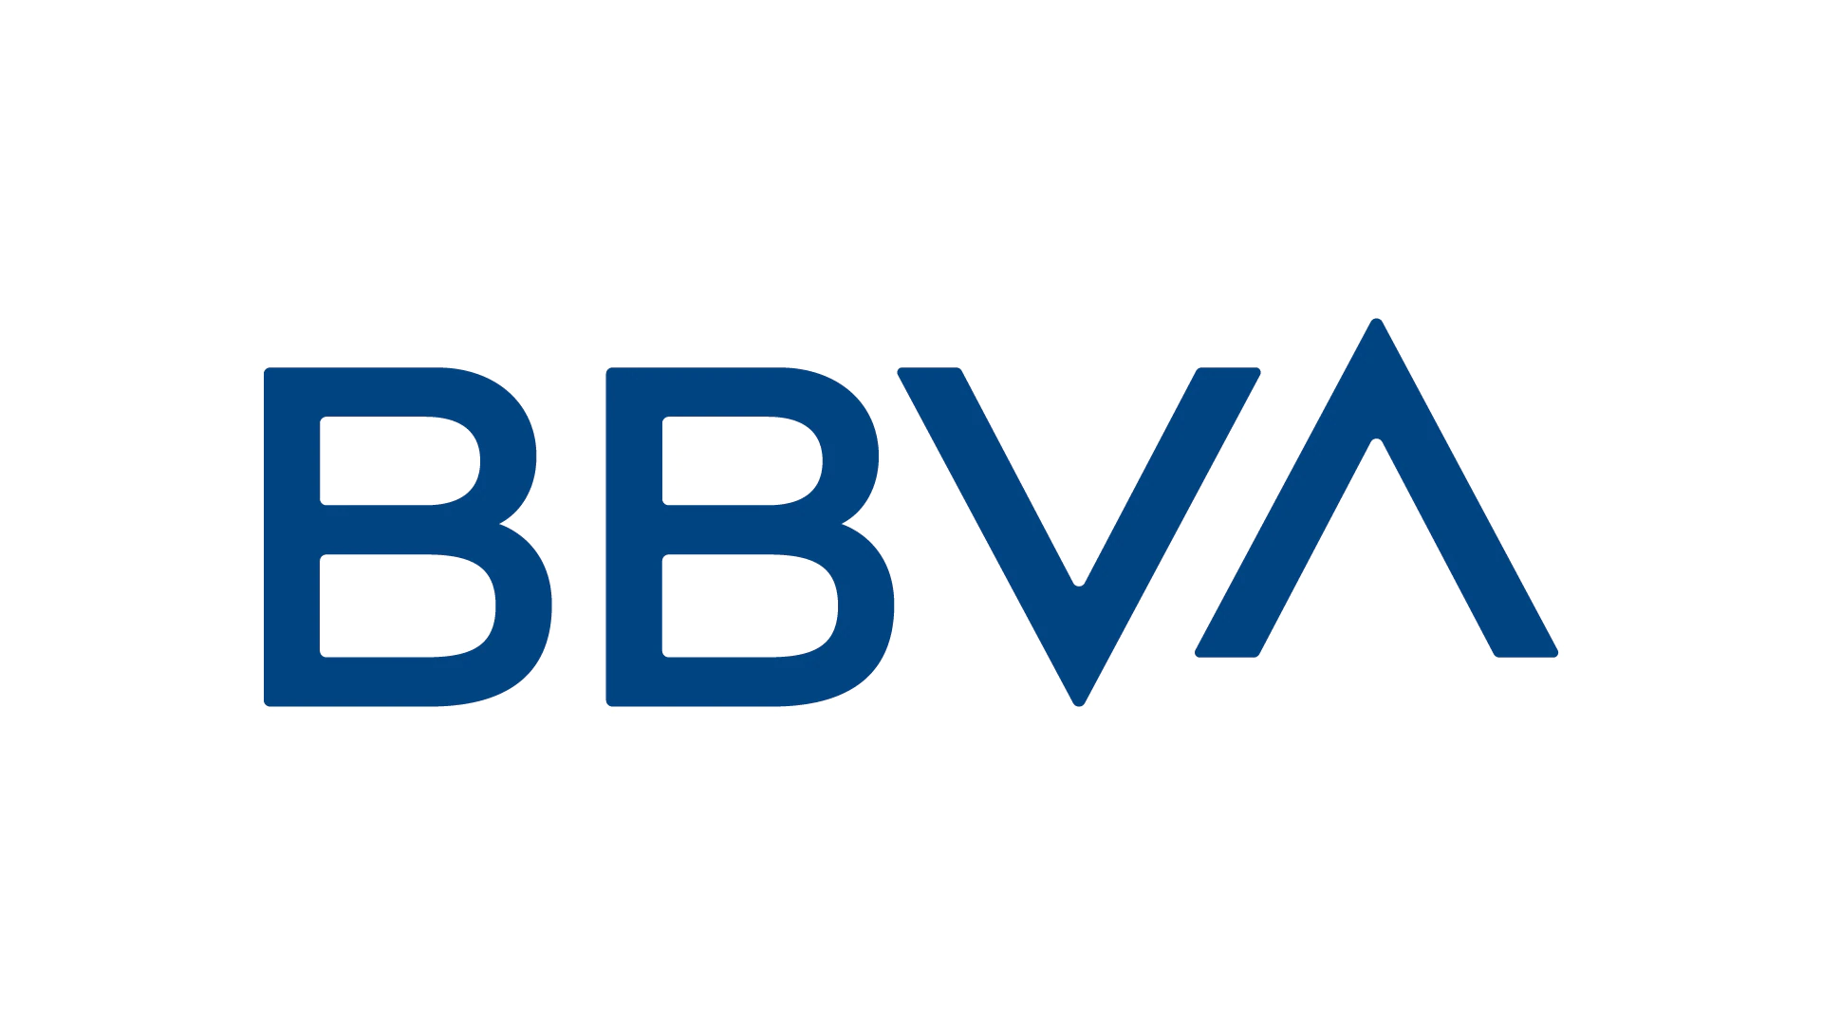


Ownerless capital can basically be seen as reserves accrued through retained earnings
In 2019, after recording a comprehensive loss of €6.1 billion, Deutsche Bank Group slashed reserves for retained earnings from €16.7 billion to €9.6 billion, while leaving common shares and related premiums unchanged at €45.8 billion

Slide 9
Outline of today’s talk
Some relevant features of Equity Certificates
The main rules on CET1 eligibility
The EBA’s concerns and the proposals by the MoF Commission
My opinion
Stakeholder banks and the risks ahead

Slide 10
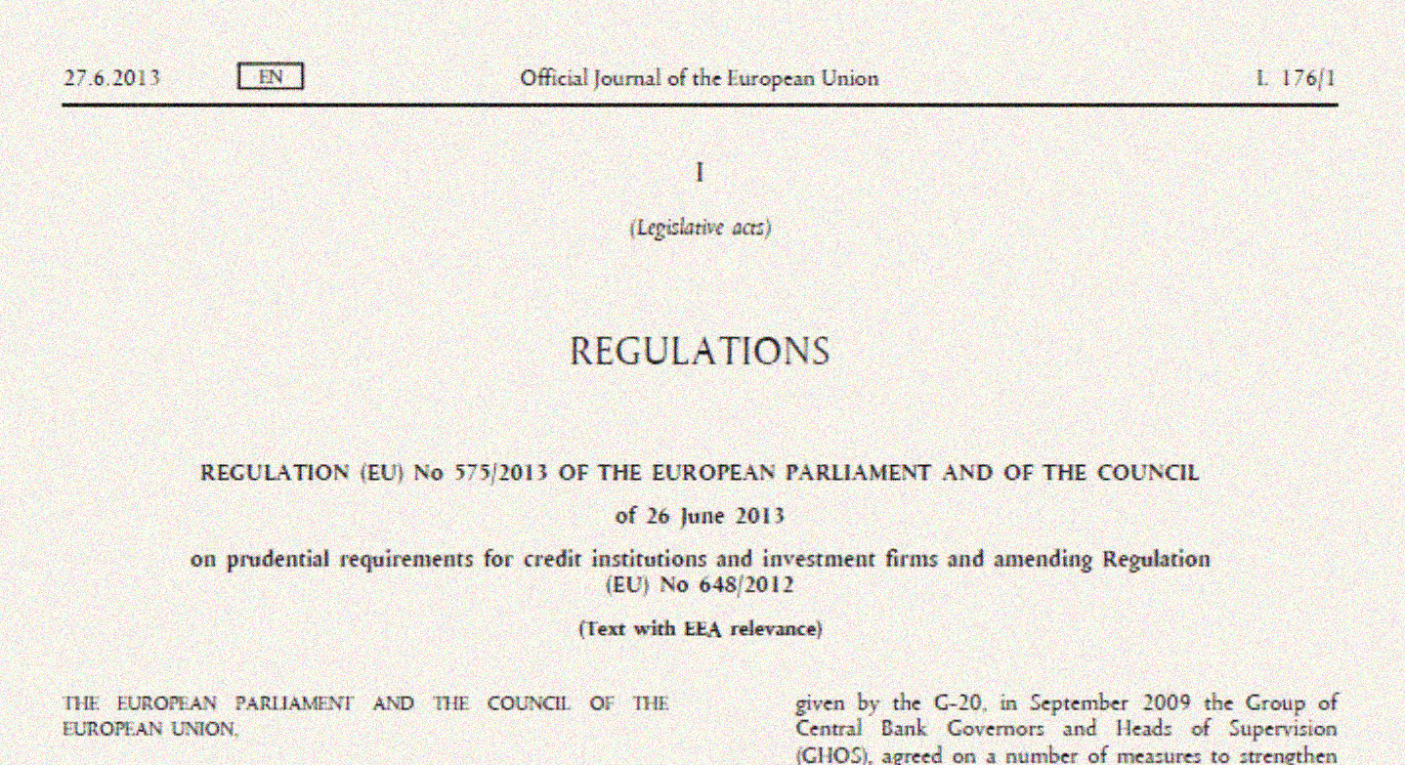
CET1 in the capital requirements regulation

Slide 11
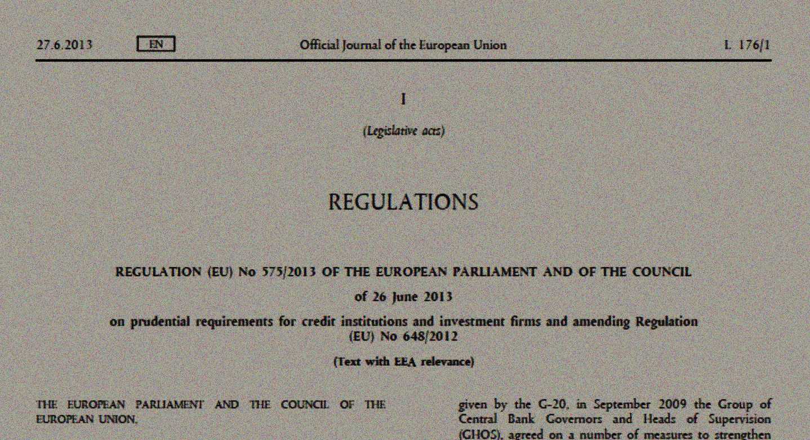
CET1 in the capital requirements regulation

Slide 12
CET1 in the CRR
CET1 Items
according to Article 26
a) Capital instruments
b) Premiums collected on a)
Other items
c) retained earnings
d) other comprehensive income
e) other reserves
f) funds for general
banking risk

Slide 13
CET1 in the CRR
Constraints on capital instruments in Article 28:
- fully paid up
- not funded nor guaranteed by the bank
- booked as equity
- clearly and separately disclosed
- perpetual
- no right to predetermined distributions
- junior in insolvency
- compared to all the capital instruments they absorb the first and proportionately greatest share of losses, and each instrument absorbs losses to the same degree as all other CET1 instruments.
CET1 Items
according to Article 26
a) Capital instruments
b) Premiums collected on a)
…
…

Slide 14
CET1 in the CRR
Constraints on capital instruments in Article 28:
- fully paid up
- not funded nor guaranteed by the bank
- booked as equity
- clearly and separately disclosed
- perpetual
- no right to predetermined distributions
- junior in insolvency
- compared to all the capital instruments they absorb the first and proportionately greatest share of losses, and each instrument absorbs losses to the same degree as all other CET1 instruments.
CET1 Items
according to Article 26
a) Capital instruments
“There are no capital instruments issued in relation to the ‘ownerless’ equity.”
“ownerless capital is not a capital instrument”
b) Premiums collected on a)

Slide 15
CET1 in the CRR
“‘Ownerless capital’ is included as CET1 item, cf. Article 26 (1)(c) of the CRR”
CET1 Items
according to Article 26
Constraints on other items in Article 26:
- they can only be recognised as CET1 if they are available to the institution for unrestricted and immediate use to cover risks or losses as soon as these occur.
Other items
c) retained earnings
d) other comprehensive income
e) other reserves
f) funds for general
banking risk

Slide 16
CET1 in the cRR: recap
Constraints on capital instruments in Article 28:
- fully paid up
- not funded nor guaranteed by the bank
- booked as equity
- clearly and separately disclosed
- perpetual
- no right to predetermined distributions
- junior in insolvency
- compared to all the capital instruments they absorb the first and proportionately greatest share of losses, and each instrument absorbs losses to the same degree as all other CET1 instruments.
CET1 Items
according to Article 26
This is the relevant requirement for ownerless capital
This comparison does not involve ownerless capital
Items that are also instruments
a) Capital instruments
Equity certificates
b) Premiums collected on a)
Constraints on other items in Article 26:
- they can only be recognised as CET1 if they are available to the institution for unrestricted and immediate use to cover risks or losses as soon as these occur.
Items that are not instruments
Other items
c) retained earnings
d) other comprehensive income
e) other reserves
f) funds for general
banking risk
Ownerless
capital

Slide 17
Outline of today’s talk
Some relevant features of Equity Certificates
The main rules on CET1 eligibility
The EBA’s concerns and the proposals by the MoF Commission
My opinion
Stakeholder banks and the risks ahead

Slide 18
The EBA’s concerns
In June 2022, the EBA raised come concerns, which could lead to removing ECs from the list of eligible CET1 instruments
  the main one relates to their ability to effectively absorb losses,
  and allegedly involves (no details were provided)
    Article 26
    Article 28.1, letter (i) of the CRR
  ECs are said not to comply with these articles because ownerless capital may absorb the first and greatest portion of losses

Slide 19
the commission’s proposals
The MoF Commission concluded that
  leaving the current rules unchanged could lead to a long-lasting legal procedure in front of the EFTA Court, triggering legal uncertainty
  Also, “the fact that an EC, “in terms of ownership, does not have rights to all the equity items in the bank” may pose a challenge in relation to the requirements of the CRR (§14.3.3.2), a concern that was never raised by the EBA in its letter
  all this calls for new rules whereby owner capital and ownerless capital
  would contribute to loss coverage on a pari passu basis (“the ownership share model”, §15.2.3 )
  this would make ECs riskier, but no other adjustments – to compensate EC holders (e.g., by increasing their voting rights) – would be required (§15.3.3)

Slide 20
Outline of today’s talk
Some relevant features of Equity Certificates
The main rules on CET1 eligibility
The EBA’s concerns and the proposals by the MoF Commission
My opinion
Stakeholder banks and the risks ahead

Slide 21
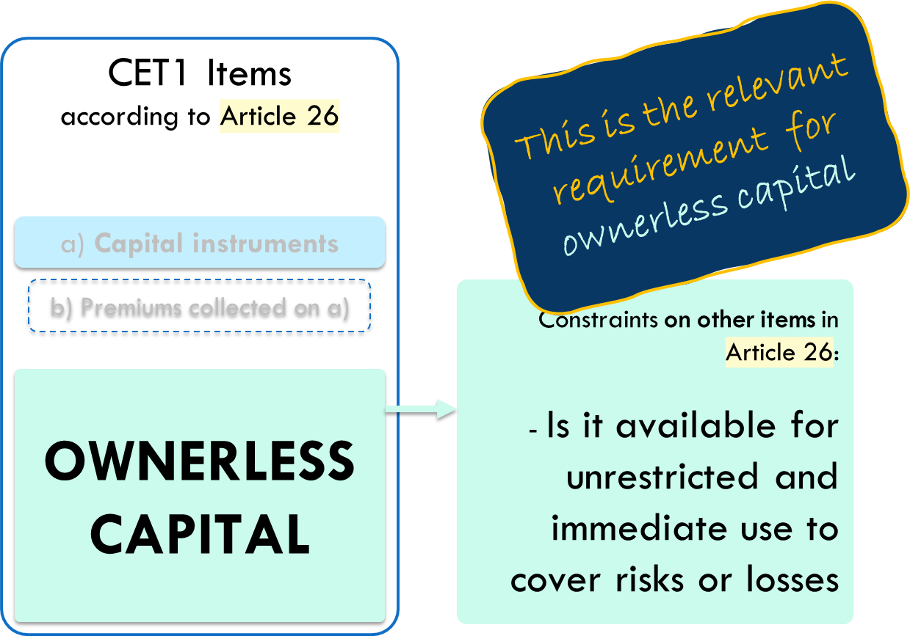






The EBA’s CONcerns: article 26
BANK
In business
In liquidation
Loss coverage
No ordinary
distributions
There is no way, under the current rules, that ownerless capital can “flee” the bank before losses are covered.
Further clarifications could be introduced in the law if the EBA believes that this is necessary
Ownerless capital
Two-thirds
majority
Prior
repayment
of creditors
and EC holders
Social
goals
Prior supervisory
approval
Conversion into equity certificates

Slide 22
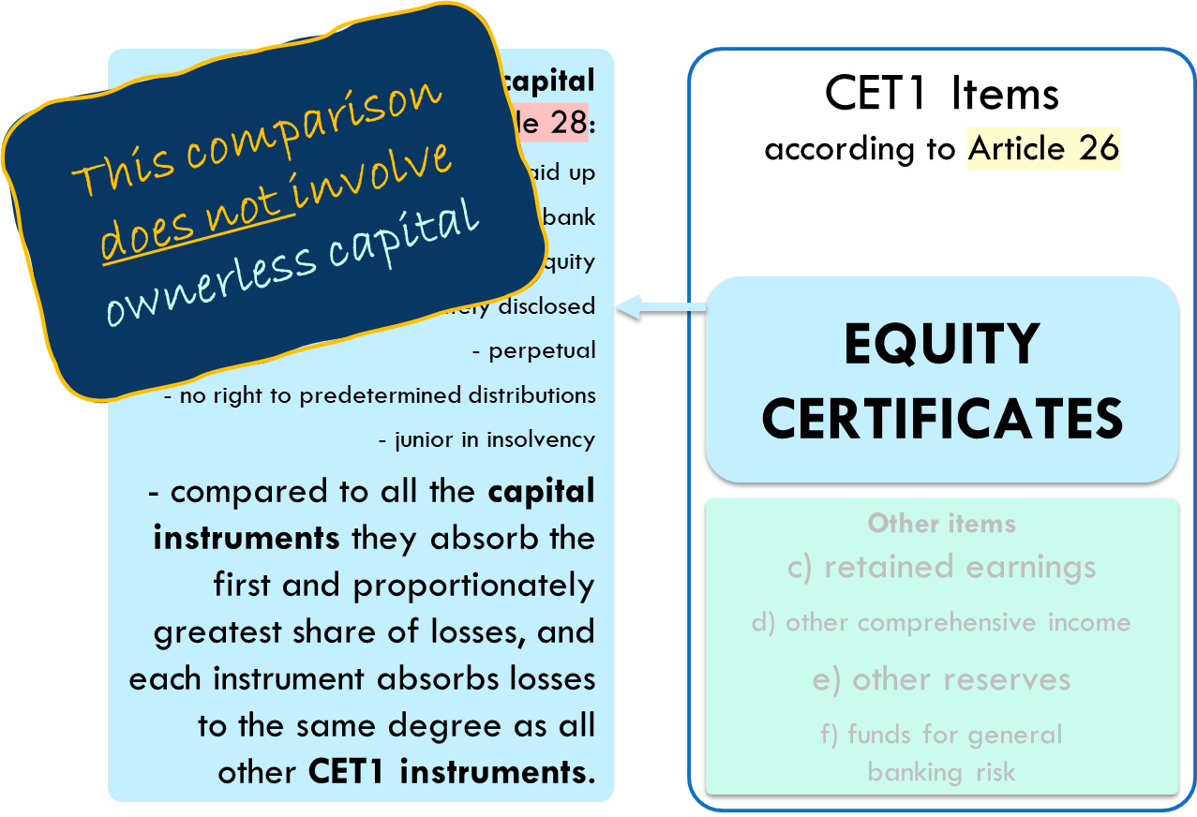
The EBA’s concerns: article 28
It is true that “Article 28(1)(i) requires that CET1 instruments have sufficient loss-absorbing capacity”, but it is unfair to say that this requirement involves a comparison between EC and ownerless capital
(including, e.g., primary capital)
Article 28.1(i) requires that CET1 instruments have sufficient loss absorbing capacity, but does so in a precise and specific way:
  It only involves a comparison
  with other capital instruments
  Therefore, it asks for no comparison with ownerless capital and its components
“savings banks have not issued other equity instruments than equity certificates”
ECs absorb “the first and proportionate largest share of the loss compared to other instruments issued in line with the requirement of the CRR cf. Article 28(1)(i)”
“There are no capital instruments issued in relation to the ‘ownerless’ equity.”
“ownerless capital is not a capital instrument”

Slide 23
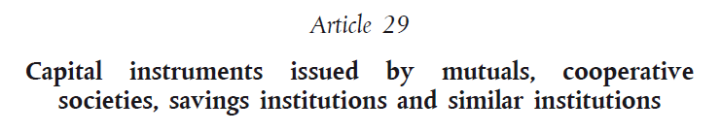
The commission’s concerns: “ECS do not have rights to all the equity items in the bank”
True, but how does that contrast
with the EU’s requirements?
  It does not, and no-one
  has shown otherwise
Indeed:
  The CRR (Article 29) explicitly provides for the possibility that savings banks issue capital instruments whose owners, in the event of liquidation, are entitled to a limited claim on the institution’s net assets
[…]
[…]

Slide 24
The commission’s concerns: “ECS do not have rights to all the equity items in the bank” /2
True, but how does that contrast with the EU’s requirements?
  It does not, and no-one has shown otherwise
Indeed:
  The CRR (Article 29) explicitly provides for the possibility that savings banks issue capital instruments whose owners, in the event of liquidation, are entitled to a limited claim on the institution’s net assets
  Regulation 241/2014 (Recital 7) openly refers to CET1 instruments that only “benefit to some extent” from a savings bank’s reserves
[…]
[…]

Slide 25
Outline of today’s talk
Some relevant features of Equity Certificates
The main rules on CET1 eligibility
The EBA’s concerns and the proposals by the MoF Commission
My opinion
Stakeholder banks and the risks ahead

Slide 26







Shareholder Banks (shb) vs. stakeholder banks (STB)
Shareholder banks are joint-stock companies aimed at producing profits for investors
Employees
No-profit
projects
Stakeholder banks
(credit cooperatives, mutual banks, savings banks, etc.) aim at producing benefits for various categories of stakeholders.
Customers
Communities
Investors
Investors

Slide 27

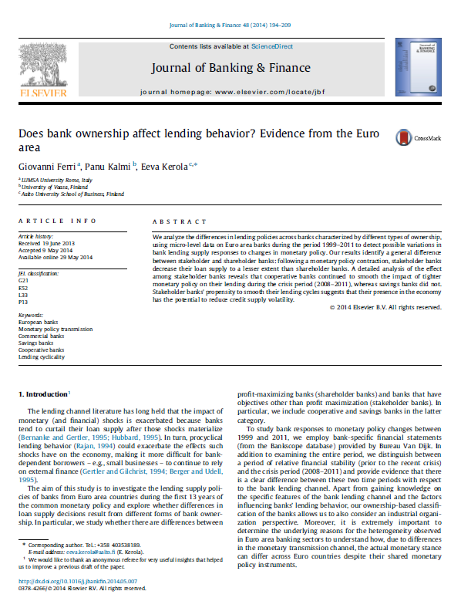
Benefits of stakeholder banks and of a diverse banking sector
STBs foster social capital and local economic development (Lang, Signore, and Gvetadze 2016)
STBs behave less procyclically and stabilize the lending cycle (Ferri, Kalmi, and Kerola, 2014)
STBs engage less in speculative activities (Prieg and Greenham, 2012)
STBs help reducing income inequalities (Minetti, Murro, and Peruzzi, 2019)
STBs have mitigated the drop in lending growth caused by the 2007-2009 global financial crisis (Meriläinen 2016;
STBs are less risky and characterised by lower profit volatility (Cihák and Hesse, 2007; Beck et al. 2009)
Savings banks are by and large as efficient as SHBs (Goddard et al., 2013; Ayadi, Schmidt, and Carbó Valverde, 2009)
STB have their own vulnerabilities, but diversity in business models (SHBs + STBs) increases the banking sector’s resilience to external shocks (Ayadi, Schmidt, and Carbó Valverde, 2009)

Slide 28

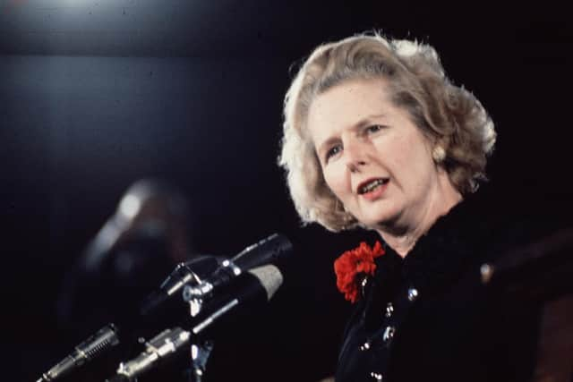
How a reform of Ecs could trigger a loss of banking diversity
EC holders lose the “loss cushion” provided by ownerless capital
Mass litigations, the market for ECs freezes, no access to new capital
Investors ask for a higher share of profits, less money for social uses
Investors ask for more voting rights, shift towards shareholder banks
In 1986 a law was passed to allow British building societies to convert into joint stock companies, in the 1990s, most building societies were demutualised, with ownerless capital being converted into equity and often sold to larger banks
This caused a huge transfer of wealth from future members and their communities to current members, who benefited from a GBP 35 billion “windfall profit”
Studies show that the ensuing lack of “biodiversity” in the banking sector made the UK more vulnerable to the 2007-2009 Great Financial Crisis

Slide 29

“In a nutshell”
No-one has ever shown that EU rules on CET1 capital require ECs to take losses on a pari passu basis with ownerless capital
Norwegian policy makers may legitimately decide to make savings banks more similar to joint stock companies, but this would not be supported by any compelling legal argument regarding CET1 eligibility
If such an avenue is chosen, everybody should be mindful of its consequences

Slide 30
EQUITY CERTIFICATES
AND THEIR ELIGIBILITY
AS CET1 CAPITAL
ANDREA RESTI
BOCCONI UNIVERSITY
andrea.resti@unibocconi.it

